Slide 1
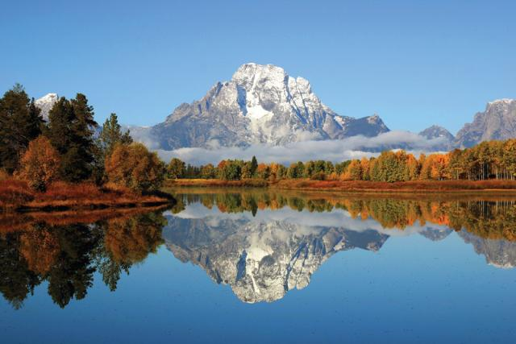
Philippians 3:1-9
Christ Alone
Preached by Dan Bridges Amman International Church, Jordan (AmmanChurch.org) Uploaded by Dr. Rick Griffith • Jordan Evangelical Theological Seminary Files in many languages for free download at BibleStudyDownloads.org

Slide 2
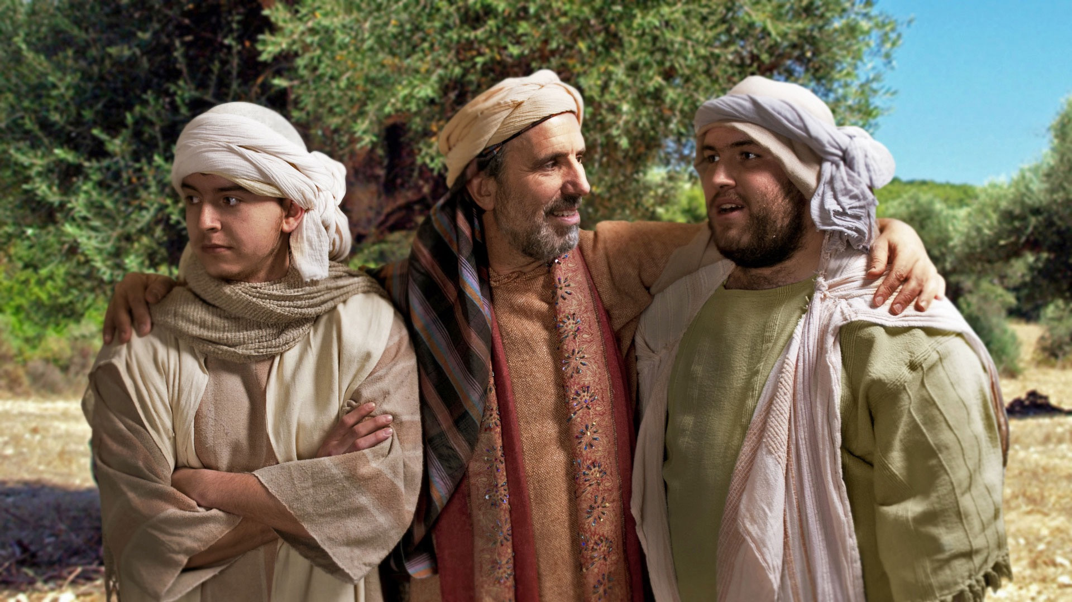
Why did Jesus tell the Parable of the “Prodigal Son”?

Slide 3
Tax collectors and other notorious sinners often came to listen to Jesus teach. This made the Pharisees and teachers of religious law complain that he was associating with such sinful people—even eating with them! Luke 15:1-2
So Jesus told them this story: If a man has a hundred sheep…
Or suppose a woman has ten silver coins…
To illustrate the point further, Jesus told them this story: A man had two sons…

Slide 4
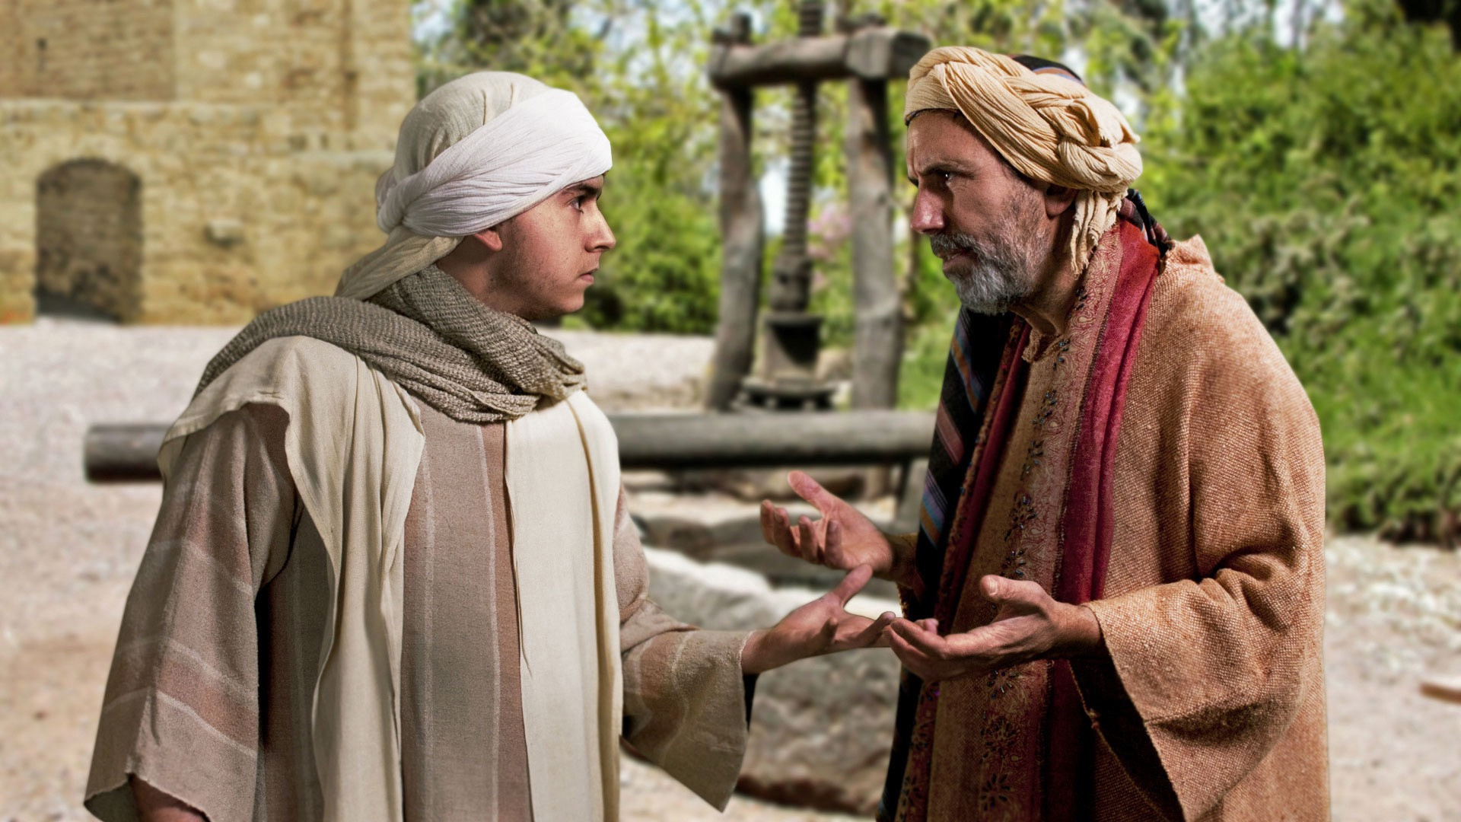

Slide 5
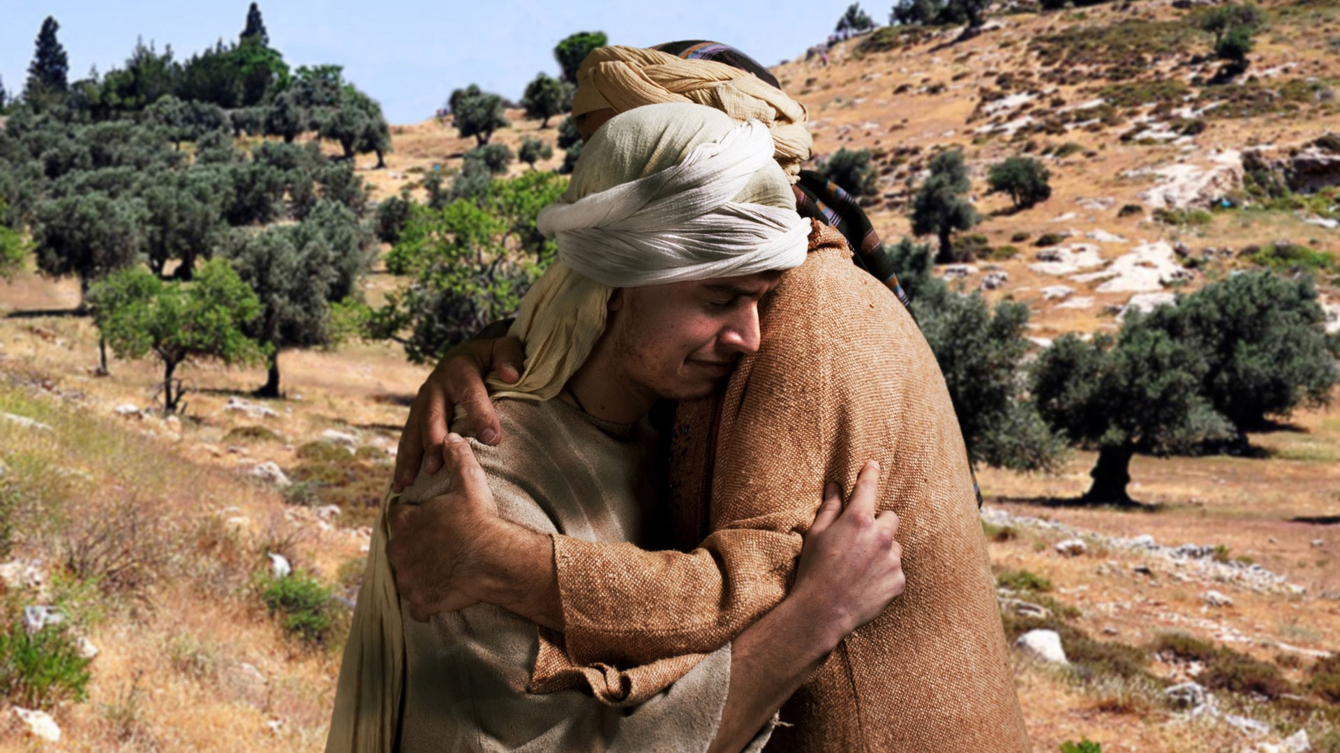
One son repented…

Slide 6
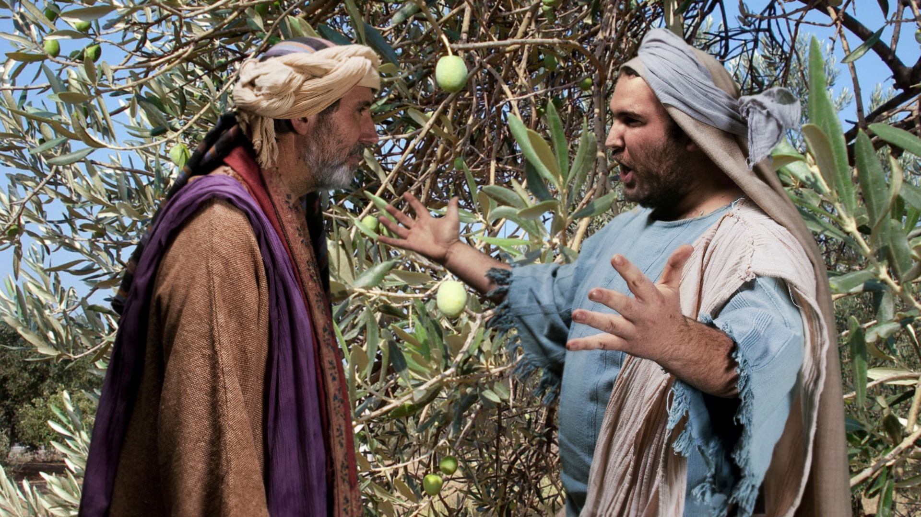
One son did not…

Slide 7
Conclusion: Two wrong ways to relate to God…
Legalism:
Believing that God accepts me based on my good works
Sensualism:
Living to please myself

Slide 8
Philippians 3
Legalism:
Verses 1-16
Sensualism:
Verses 17-21

Slide 9
Finally, my brothers, rejoice in the Lord. To write the same things to you is no trouble to me and is safe for you. Philippians 3:1

Slide 10
Finally, my brothers, rejoice in the Lord. To write the same things to you is no trouble to me and is safe for you. Philippians 3:1
Rejoicing in the Lord is the antidote to both problems:
Sensualist: Rejoices in their own pleasure
Legalist: Rejoices in the own good works

Slide 11
¹ Finally, my brothers, rejoice in the Lord. To write the same things to you is no trouble to me and is safe for you.
² Look out for the dogs, look out for the evildoers, look out for those who mutilate the flesh. ³ For we are the circumcision, who worship by the Spirit of God and glory in Christ Jesus and put no confidence in the flesh— Philippians 3:1-3

Slide 12
⁴ though I myself have reason for confidence in the flesh also. If anyone else thinks he has reason for confidence in the flesh, I have more: ⁵ circumcised on the eighth day, of the people of Israel, of the tribe of Benjamin, a Hebrew of Hebrews; as to the law, a Pharisee; ⁶ as to zeal, a persecutor of the church; as to righteousness under the law, blameless. Philippians 3:4-6

Slide 13
⁷ But whatever gain I had, I counted as loss for the sake of Christ. ⁸ Indeed, I count everything as loss because of the surpassing worth of knowing Christ Jesus my Lord. For his sake I have suffered the loss of all things and count them as rubbish, in order that I may gain Christ ⁹ and be found in him, not having a righteousness of my own that comes from the law, but that which comes through faith in Christ, the righteousness from God that depends on faith Philippians 3:7-9

Slide 14
Legalism / Confidence in the Flesh:
The Danger (vs 2)
The Truth (vs 3)
The Testimony (vss 4-6)
The Evaluation (vss 7-9)

Slide 15
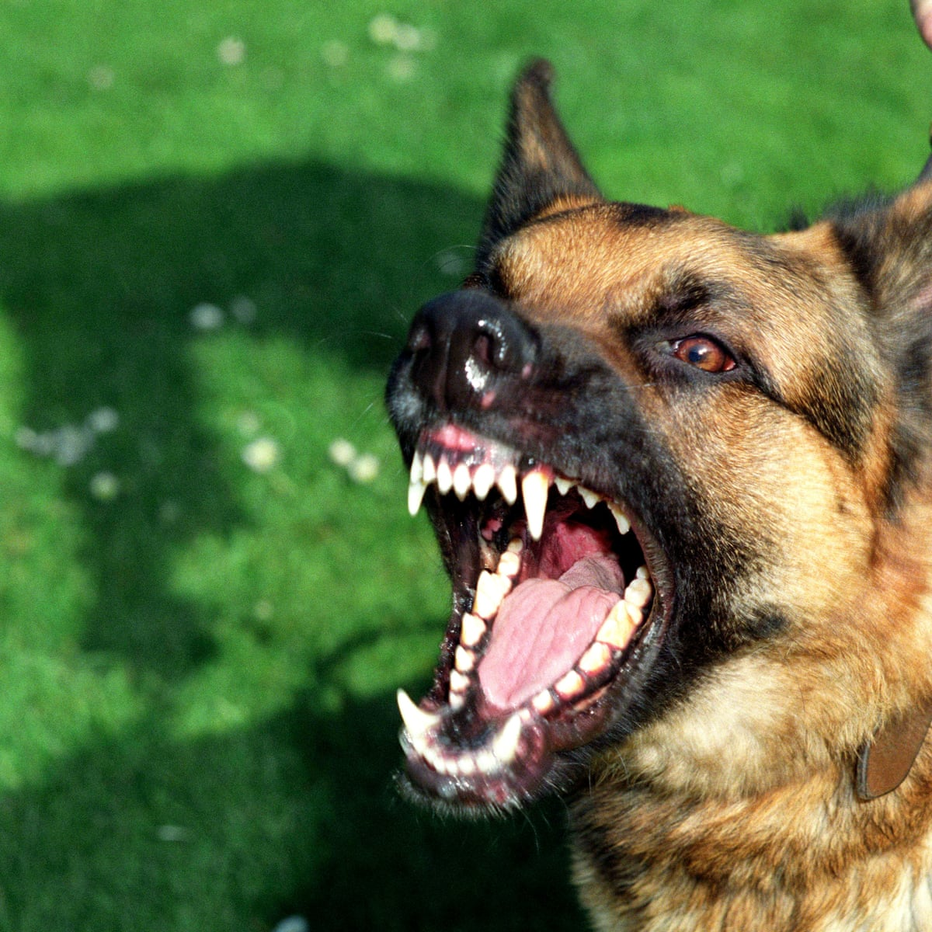
The Danger:
Look out for the dogs, look out for the evildoers, look out for those who mutilate the flesh.
Philippians 3:2

Slide 16
Judaizers:
Believing in Jesus is a start but…
You also need to be circumcised and obey the Law of Moses

Slide 17
Legalism / Confidence in the Flesh:
The Danger
The Truth (3)
The Testimony
The Evaluation

Slide 18
The Truth:
For we are the [true] circumcision, who worship by the Spirit of God and glory in Christ Jesus and put no confidence in the flesh…
Philippians 3:3

Slide 19
For we are the [true] circumcision, who worship by the Spirit of God and glory in Christ Jesus and put no confidence in the flesh…
Philippians 3:3
Why these three characteristics?

Slide 20
worship by the Spirit of God…
rather than with external things (sacrifices, circumcision, etc.)
glory in Christ Jesus…
rather than our own performance
put no confidence in the flesh…
(for our acceptance before God)
but rather on Jesus’ work on our behalf

Slide 21
What does it Mean to “Glory in Christ Jesus”?
²³ Thus says the Lord: “Let not the wise man boast in his wisdom, let not the mighty man boast in his might, let not the rich man boast in his riches, ²⁴ but let him who boasts boast in this, that he understands and knows me, that I am the Lord who practices steadfast love, justice, and righteousness in the earth. For in these things I delight, declares the Lord.”
Jeremiah 9:23-24

Slide 22
Legalism / Confidence in the Flesh:
The Danger
The Truth
The Testimony (4-6)
The Evaluation

Slide 23
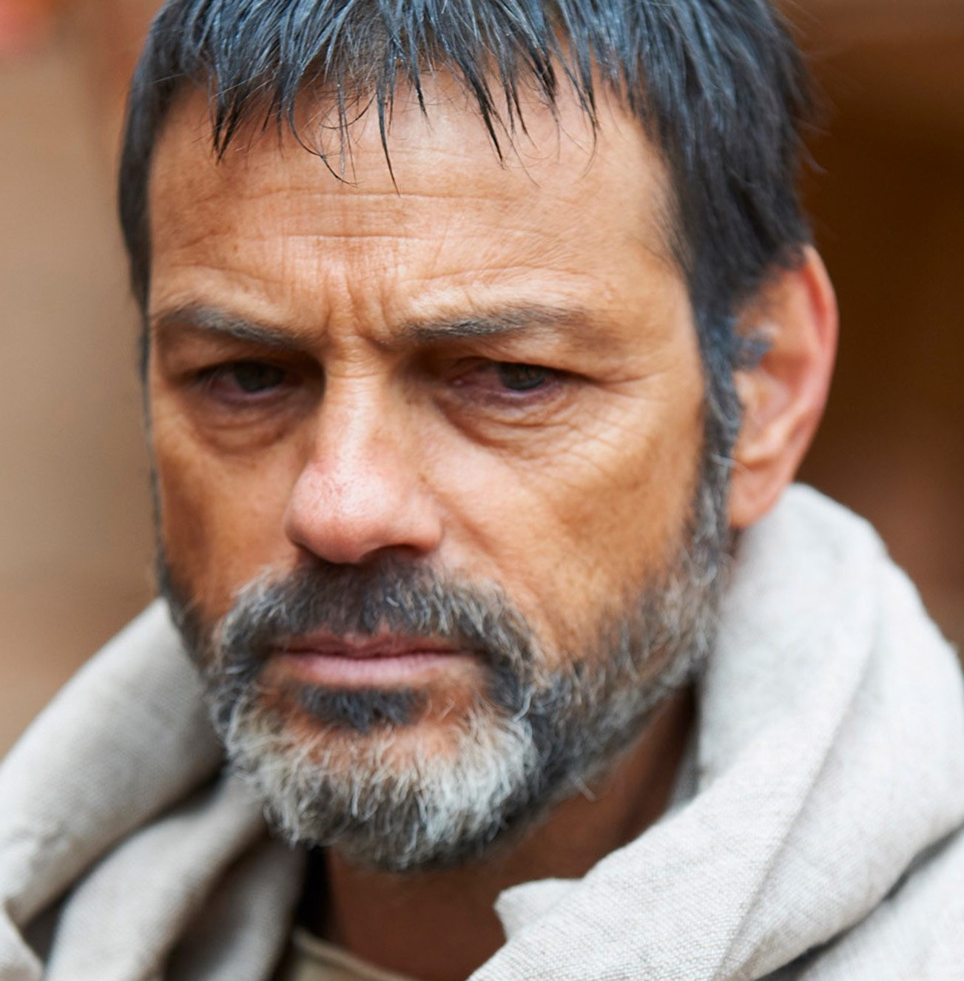
The Testimony:
though I myself have reason for confidence in the flesh also. If anyone else thinks he has reason for confidence in the flesh, I have more…
Philippians 3:4

Slide 24
Inherited fleshly advantages:
circumcised on the eighth day
(Born a Jew)
of the people of Israel
(Lineage back to Abraham)
of the tribe of Benjamin
(loyal to David’s line, highly respected)
a Hebrew of Hebrews
(not Hellenized; maintained Jewish culture and language)

Slide 25
Attained fleshly advantages:
as to the law, a Pharisee
(member of the purist religious sect)
as to zeal, a persecutor of the church
(actively going after perceived enemies of the Jewish faith)
as to righteousness under the law, blameless
(No one could accuse him of breaking the Jewish law in any way!)

Slide 26
Profit Sheet:
√
√
√
√
√
√
√
Inherited fleshly advantages:
circumcised on the eighth day
of the people of Israel
of the tribe of Benjamin
a Hebrew of Hebrews
Attained fleshly advantages:
as to the law, a Pharisee
as to zeal, a persecutor of the church
as to righteousness under the law, blameless

Slide 27
Legalism / Confidence in the Flesh:
The Danger
The Truth
The Testimony
The Evaluation (7-9)

Slide 28
But whatever gain I had, I counted as loss for the sake of Christ.
Philippians 3:7
Gain… in what sense?
Acceptance before God!

Slide 29
Loss Sheet:
X
X
X
X
X
X
X
Inherited fleshly advantages:
circumcised on the eighth day
of the people of Israel
of the tribe of Benjamin
a Hebrew of Hebrews
Attained fleshly advantages:
as to the law, a Pharisee
as to zeal, a persecutor of the church
as to righteousness under the law, blameless

Slide 30
But whatever gain I had, I counted as loss for the sake of Christ.
Philippians 3:7
Counted… and still count

Slide 31
Loss Sheet:
X
X
X
X
X
X
X
Inherited fleshly advantages:
circumcised on the eighth day
of the people of Israel
of the tribe of Benjamin
a Hebrew of Hebrews
Attained fleshly advantages:
as to the law, a Pharisee
as to zeal, a persecutor of the church
as to righteousness under the law, blameless
Why a loss rather than just neutral?

Slide 32
⁸ Indeed, I count everything as loss because of the surpassing worth of knowing Christ Jesus my Lord. For his sake I have suffered the loss of all things and count them as rubbish, in order that I may gain Christ ⁹ and be found in him, not having a righteousness of my own that comes from the law, but that which comes through faith in Christ, the righteousness from God that depends on faith
Philippians 3:8-9

Slide 33
Three Questions:
What things did Paul consider a loss?
Why did he consider them a loss?
What was his gain?

Slide 34
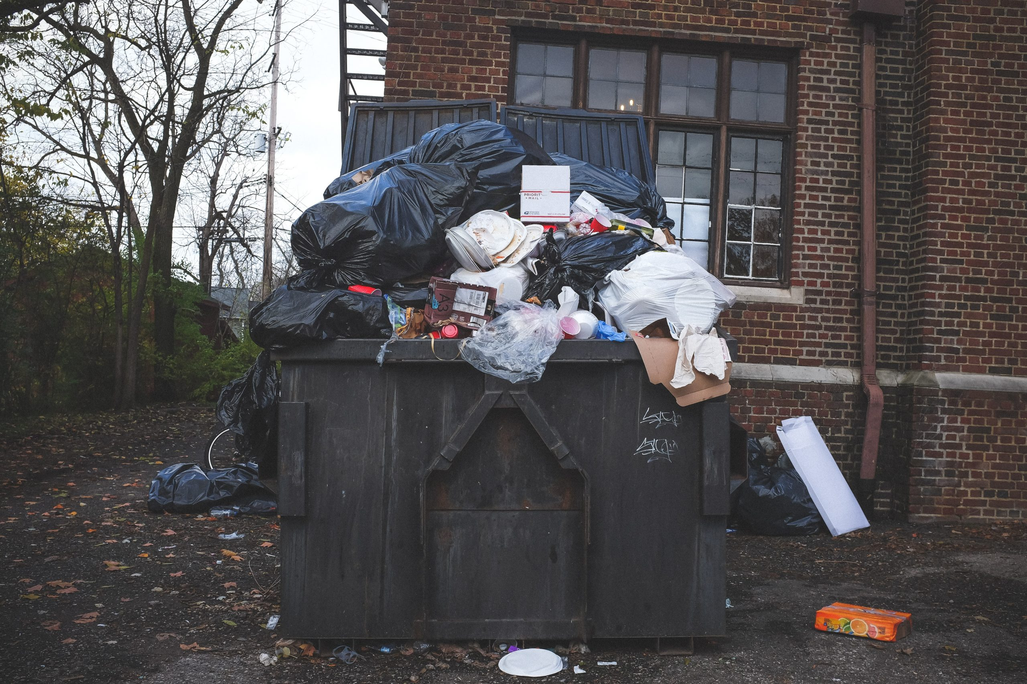
1. What things did Paul consider a loss?
1. Anything on his “Plus List” for God
Pre-Christ Days:
Post-Christ Days:
Spiritual “Pedigree”
# of Churches Started
Seminary under Gamaliel
Persecutions
Fabulous Law-Keeping
Service to Christ
Spiritual Position
Spiritual accomplishments

Slide 35
1. What things did Paul consider a loss?
2. Anything on his “Plus List” for Himself
Easy life
Money
Status
Freedom
Family (parents)
Friendships
Marriage & Family
For his sake I have suffered the loss of all things…

Slide 36
2. Why did Paul consider everything a loss?
While all potentially good things, none of these made him righteous before God!
Pre-Christ Days:
Post-Christ Days:
Spiritual “Pedigree”
# of Churches Started
Seminary under Gamaliel
Persecutions
Fabulous Law-Keeping
Service to Christ
Spiritual Position
Spiritual accomplishments

Slide 37
2. Why did Paul consider everything a loss?
They were of no value compared to the surpassing greatness of knowing Christ!
Easy life
Money
Status
Freedom
Family (parents)
Friendships
Marriage & Family

Slide 38
3. What was his gain?
⁸ Indeed, I count everything as loss because of the surpassing worth of knowing Christ Jesus my Lord. For his sake I have suffered the loss of all things and count them as rubbish, in order that I may gain Christ ⁹ and be found in him, not having a righteousness of my own that comes from the law, but that which comes through faith in Christ, the righteousness from God that depends on faith
Philippians 3:8-9

Slide 39
3. What was his gain?
⁸ Indeed, I count everything as loss because of the surpassing worth of knowing Christ Jesus my Lord. For his sake I have suffered the loss of all things and count them as rubbish, in order that I may gain Christ ⁹ and be found in him, not having a righteousness of my own that comes from the law, but that which comes through faith in Christ, the righteousness from God that depends on faith
Philippians 3:8-9

Slide 40
3. What was his gain?
In Christ, Paul had:
Communion with God

Slide 41
Communion with God
To have communion with God is to have an ongoing, intimate dependence on and relationship with God!
And this is eternal life, that they know you, the only true God, and Jesus Christ whom you have sent. John 17:3

Slide 42
3. What was his gain?
⁸ Indeed, I count everything as loss because of the surpassing worth of knowing Christ Jesus my Lord. For his sake I have suffered the loss of all things and count them as rubbish, in order that I may gain Christ ⁹ and be found in him, not having a righteousness of my own that comes from the law, but that which comes through faith in Christ, the righteousness from God that depends on faith
Philippians 3:8-9

Slide 43
3. What was his gain?
In Christ, Paul had:
Communion with God
Righteous standing before God

Slide 44
Righteousness
To be righteous before God means that you meet the complete standards of God’s law as one who has fully kept it!
For our sake he made him to be sin who knew no sin, so that in him we might become the righteousness of God. 2 Corinthians 5:21

Slide 45
3. What was his gain?
⁸ Indeed, I count everything as loss because of the surpassing worth of knowing Christ Jesus my Lord. For his sake I have suffered the loss of all things and count them as rubbish, in order that I may gain Christ ⁹ and be found in him, not having a righteousness of my own that comes from the law, but that which comes through faith in Christ, the righteousness from God that depends on faith
Philippians 3:8-9

Slide 46
Main Idea
Glory in Christ since he alone makes you righteous so you can relate with God.

Slide 47
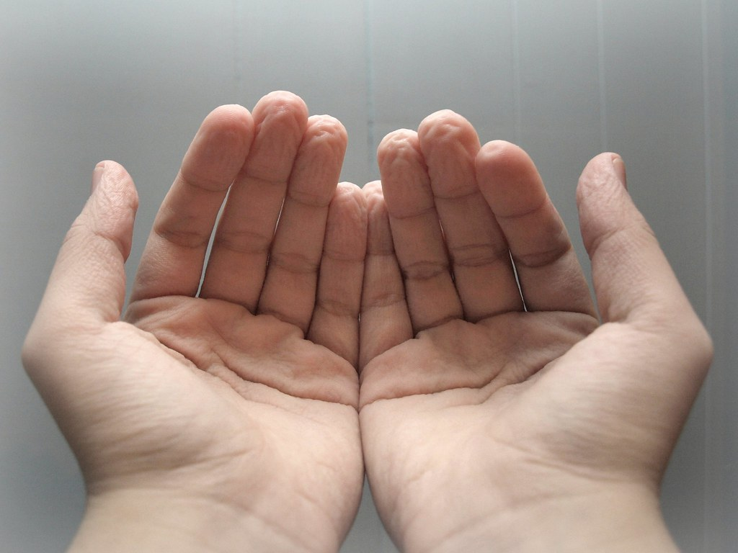
To Become a Believer
Repent of your sin
Repent of your efforts to be accepted by God on your own merit
Accept, by faith, the righteousness God is offering
Faith!
Notes:
“Faith is an empty hand taking the provision made by another.”

Slide 48
As a Believer
Remind yourself regularly that your relationship with God is based on Christ alone.
Live your daily life in dependence on the merit and power of Christ – Christ alone!

Slide 50
NT Preaching link at BibleStudyDownloads.org
Get this presentation for free!
Notes:
NT Preaching (np)

